Slide 1

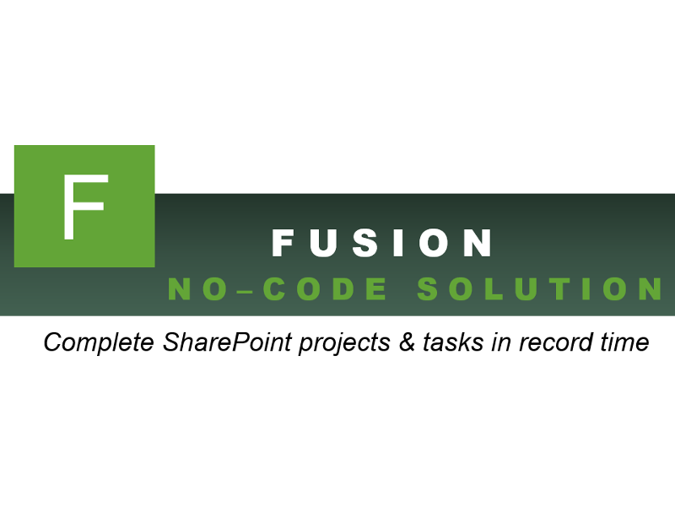


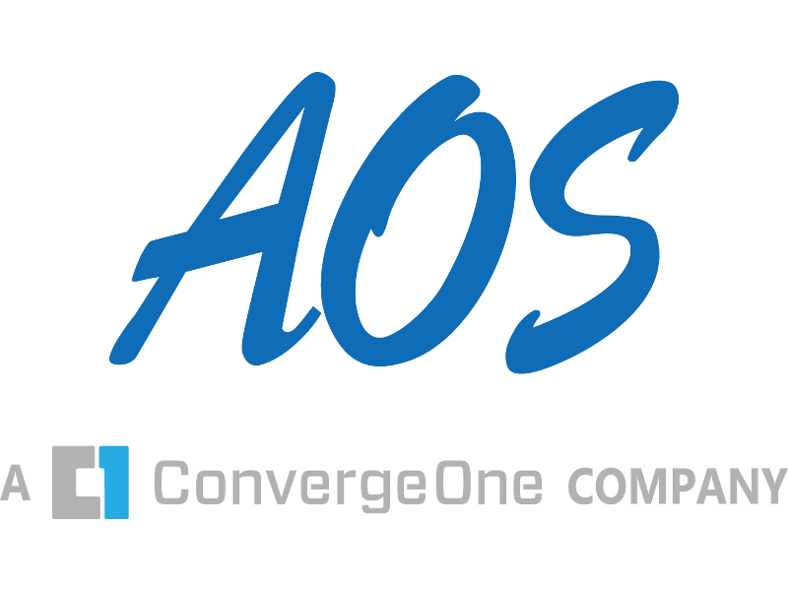

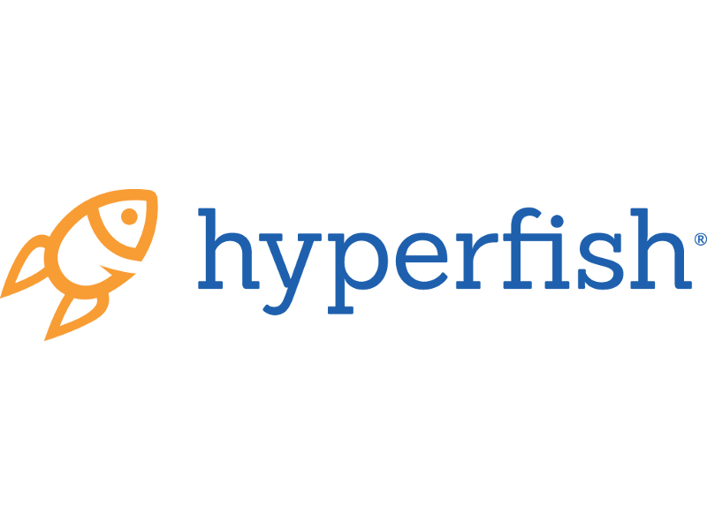






Thank You
Sponsors!

Slide 2
Using the Office Dev PNP to Accelerate Your Productivity
SharePoint Saturday Omaha
April 7, 2018
Presented By
Ryan Schouten

Slide 3

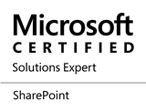
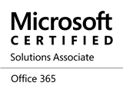


About Me
Ryan Schouten
Utah SharePoint User Group President
Worked with SharePoint for > 10 years
I have experience with SharePoint 2003 – 2016
I have worked with ASP.Net for 15 years
Microsoft MVP – Office Servers and Services
http://www.sharepointknight.com

Slide 4
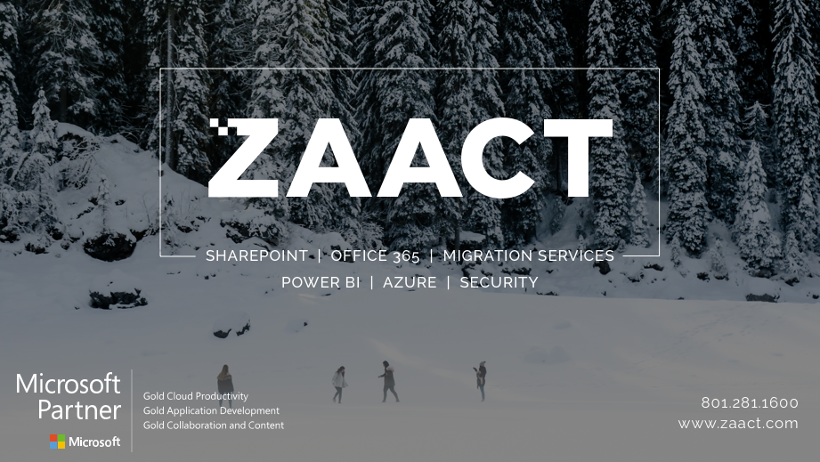

Slide 5
Patterns and Practices?
Open source initiative coordinated by SharePoint engineering
A channel for the SharePoint engineering to share
Documentation
Guidance
Samples
Reusable components for the community

Slide 6
Guidance and Samples
Webcasts and blog articles describing various topics
Outlines best practices for discussed areas
Several articles a month
Debugging SharePoint Framework solutions with Visual Studio Code
Guidelines for developing well performing SharePoint Online portals

Slide 7
PowerShell
Library of PowerShell commands to perform complex provisioning and artifact management
Uses CSOM so works against SPO and On-Prem
200+ command-lets for working with SharePoint across 25 different areas
Updated with new features on an almost monthly cadence

Slide 8
Install PowerShell Commandlets
If on Windows 10 install from PowerShell Gallery
Use Update-Module to get latest updates
If not download from PnP releases
https://github.com/officedev/pnp-powershell/releases
SharePoint Version | Command to install
SharePoint Online | Install-Module SharePointPnPPowerShellOnline
SharePoint 2016 | Install-Module SharePointPnPPowerShell2016
SharePoint 2013 | Install-Module SharePointPnPPowerShell2013

Slide 9
Provisioning Engine
PnP Remote Provisioning Engine is open source, community driven remote provisioning engine for SharePoint Online and on-premises (2013 & 2016)
Remotely extract and apply customizations and assets to/from SharePoint site
Can be used as part of the PnP PowerShell and as part of the PnP Core for custom projects

Slide 10
Demo
https://www.youtube.com/watch?v=Pw6FIysk2FY

Slide 11
SP-PnP-JS
The Patterns and Practices JavaScript Core Library was created to help developers by simplifying common operations within SharePoint and the SharePoint Framework
Fluent API for working with the full SharePoint REST API as well as utility and helper functions

Slide 12
Demo
https://youtu.be/ydgSi6r4yo8

Slide 13
Azure Functions
Scalable web services
Can use different languages:
C#
JavaScript
F#
Python
PHP
Batch
Bash
PowerShell
Notes:
http://johnliu.net/blog/2016/11/build-your-pnp-site-provisioning-with-powershell-in-azure-functions-and-run-it-from-flow

Slide 14
Demo
https://youtu.be/kh6aRSRM_yo

Slide 15

Questions

Slide 16
Thank You
www.sharepointknight.com
@shrpntknight
ryan@sharepointknight.com

